Slide 1
Digital portfolio student Name: M.Jeevitha
Register And naan muthalvan id: 2428c0190/
Department: school of computer Studies
College: AVP COLLEGE OF ARTS AND SCIENCE
asbruaj2428c0190

Slide 2
Digital portfolio
Using frontend development
• html
• css
• js

Slide 3
Problem Statement
Project overview
End users
Tools and technologies
Portfolio design and layout
Features and functionality
Results and screenshots
Conclusion
Github link

Slide 4
Problemstatement
In today's competitive job market, B.B.A graduates require a professional platform to effectively present their educational qualifications, skills, and achievements. A digital portfolio will serve as a modern alternative to a traditional resume, enabling me to showcase my strengths in communication, analytical thinking, and adaptability while creating better opportunities for career growth and professional networking.

Slide 5
Projectoverview
This project focuses on creating a digital portfolio that highlights my academic background, professional skills, and personal achievements in the field of Business Administration. The portfolio is designed to serve as an interactive and accessible platform that not only presents my resume but also demonstrates my strengths in communication, analytical thinking, and adaptability. It provides potential employers and academic institutions with a clear view of my capabilities, while enhancing my professional presence in the digital space.End User

Slide 6
End users
The end users of this digital portfolio are potential employers, recruiters, academic institutions, and professional networks who seek to evaluate my educational qualifications, skills, and achievements in Business Administration. It also serves as a reference for peers and mentors to understand my professional growth and capabilities.

Slide 7
Tools and techniques
The digital portfolio is developed using HTML, CSS, and JavaScript for designing and structuring the content. Techniques such as responsive web design, user-friendly navigation, and interactive elements are applied to ensure accessibility across devices and to present academic and professional information in an organized manner.

Slide 8
Design and layout
The digital portfolio is designed with a clean and professional layout, using a simple color scheme and structured sections such as career objective, educational qualifications, skills, languages, and hobbies. The layout ensures easy navigation and a responsive design, making the portfolio accessible on desktops, tablets, and mobile devices.

Slide 9
Features and functionality
The digital portfolio includes features such as personal introduction, career objective, educational details, skill highlights, and hobbies. It also provides easy navigation, responsive design, and interactive sections to make the content engaging and accessible. The functionality ensures that users can quickly view academic and professional information in an organized manner.

Slide 10
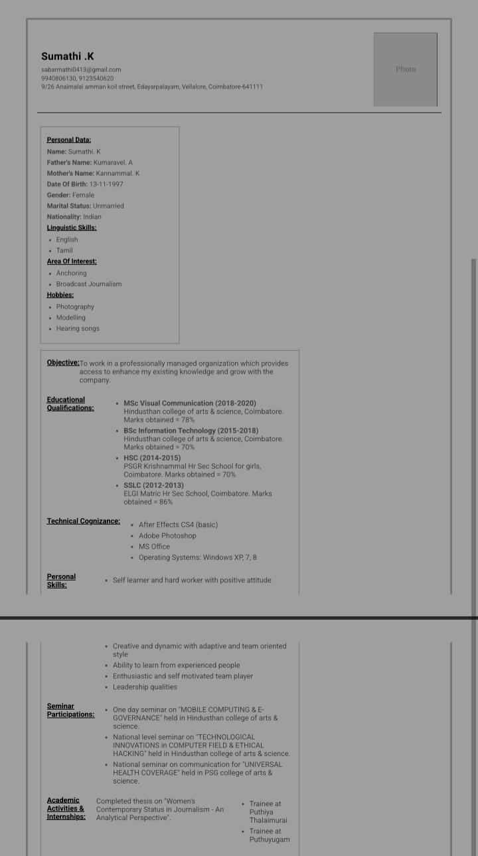
Results
The digital portfolio was successfully developed with a professional design and responsive layout. It effectively displays my personal details, academic qualifications, skills, and career objectives in an organized manner. The portfolio provides a user-friendly interface that enhances accessibility and professional presentation

Slide 11
Conclusion
The digital portfolio provides a professional platform to present my qualifications, skills, and achievements in Business Administration. It strengthens my career readiness by offering an organized, accessible, and modern representation of my profile to potential employers and academic institutions

